Slide 1
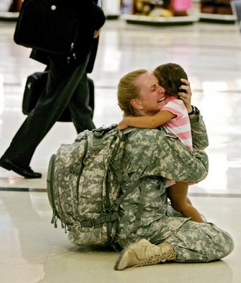
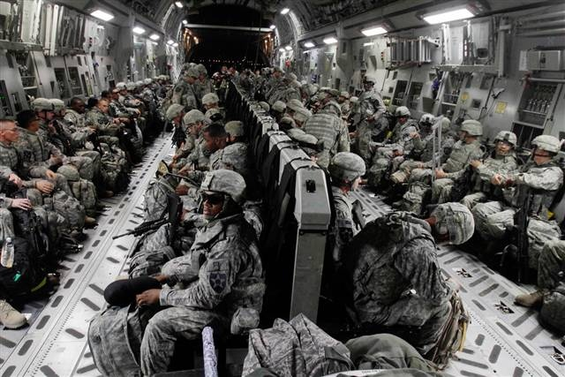
Week Two: Coming Home

Slide 2

Korean war veterans
The Korean War was never a popular war – never more than 40% of Americans expressed support for the war. It was regarded by many as the war that was impossible to win.
Not even called a “war,” Truman called it a “police action.”
As would be in the case in the Vietnam War, soldiers returned after 12 months one-by-one.
Eugene Kinkead’s book that looked at “brainwashing” endured by American GI’s.
Conditions in POW camps were dreadful. 38% died in captivity (compare to 11% in WWII, 14% in Vietnam War)

Slide 3
Vietnam War Veterans
All returned after 12 months in Vietnam singly, not to cheering civilians or parades, but just to the sense that the war was over, at least for them.
Knowing the divided public opinion about the war, many didn’t even mention their service.
Some felt as if they were returning like ghosts
They often sought the companionship of other groups
“Rap groups” gave vets a chance to be with others who had some sense of what they had experienced.
Others felt trapped between their own generation and their parent’s generation, belonging to neither.

Slide 4
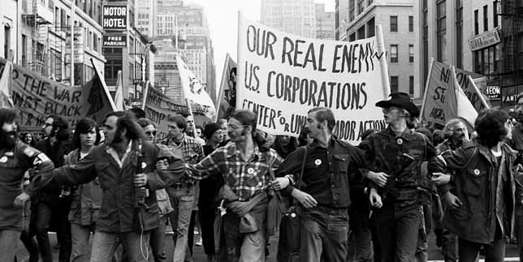
Some vets joined the antiwar movement. Never before had veterans organized in open opposition to a war, their war, while it was going on and questioned not just the war but the corporate interests that they felt were fueling it.

Slide 5
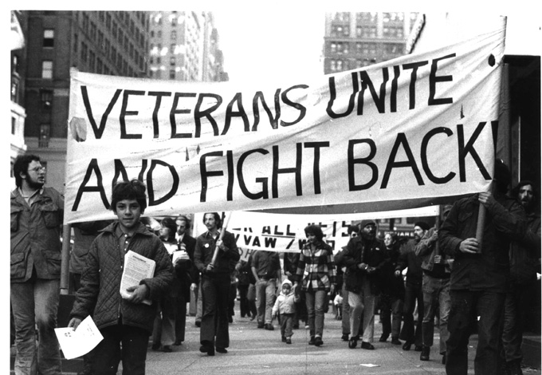
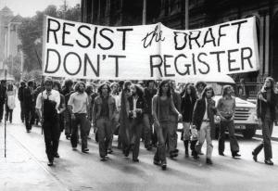
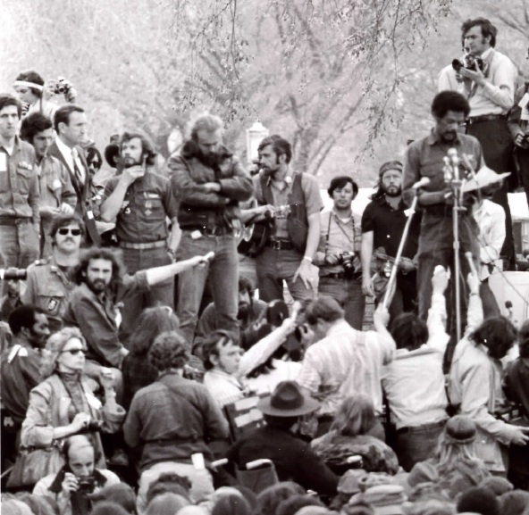
They burned draft cards, encouraged others to resist or flee to Canada, and they demonstrated a distrust of institutions and authorities.

Slide 6

Hollywood broadcast the plight of returning veterans. Note the 1978 film starring Jon Voight, Jane Fonda and Bruce Dern, Coming Home

Slide 7

POWs “Operation Homecoming”

Slide 8
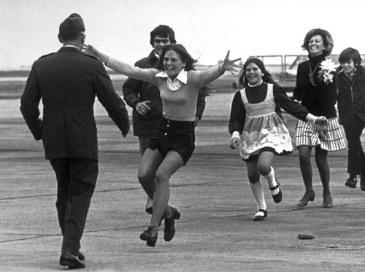
Prisoners of War

Slide 9
Iraq and Afghan War Vets
They are returning as units
Many have endured 4, 5, 6 deployments
Many are returning as disabled vets with serious physical wounds
Others suffer from chronic non-visible wounds (PTSD and TBI)
Treatments for these are still works in progress. Everything from conventional talk therapy to prescription drugs to marijuana to “digital homeopathy” is being tried.
The Veteran’s medical system is overloaded, and there are long waits for treatment in some areas of the country.
Suicide among vets is higher than their peers in the civilian population.
Many return to problems on the home front.

Slide 10
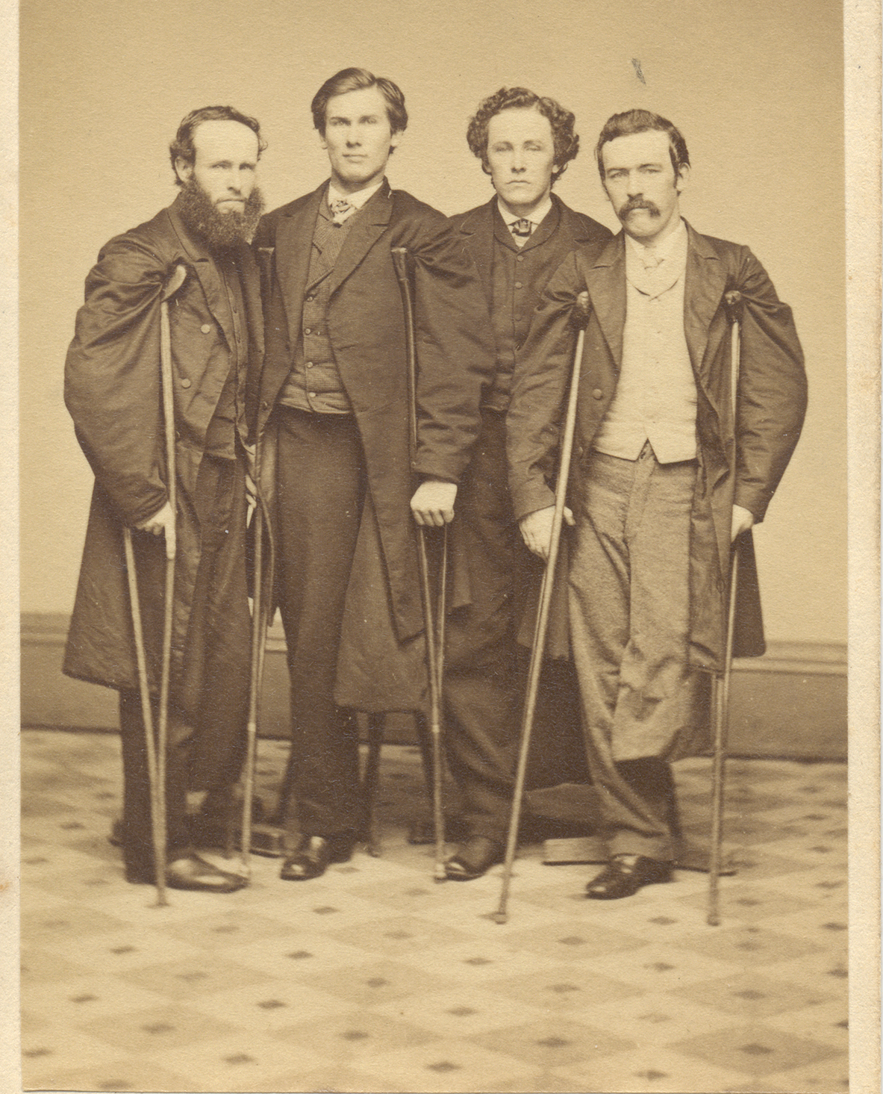
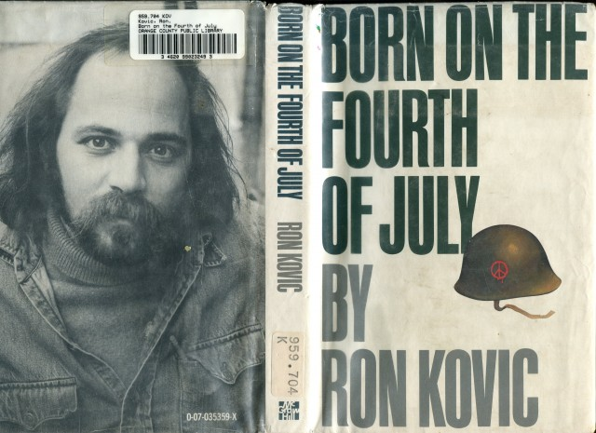
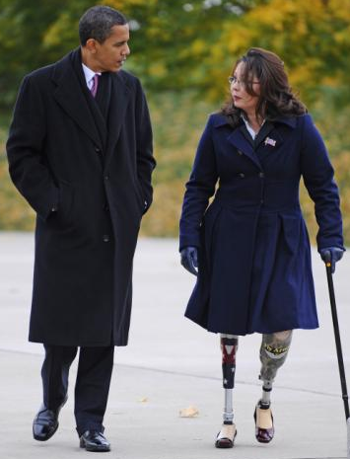
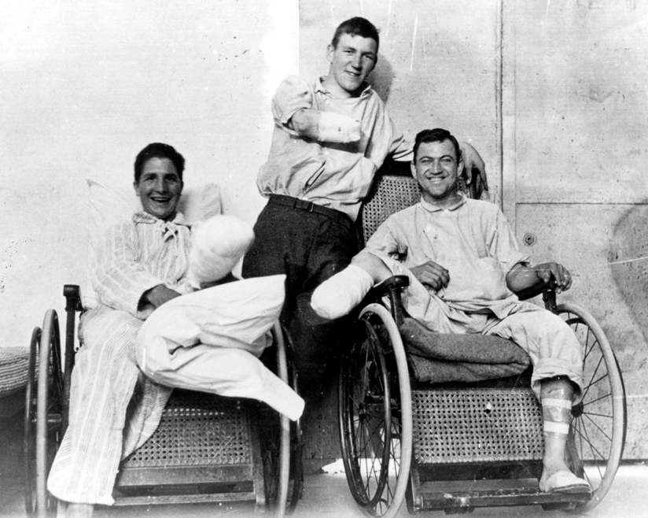
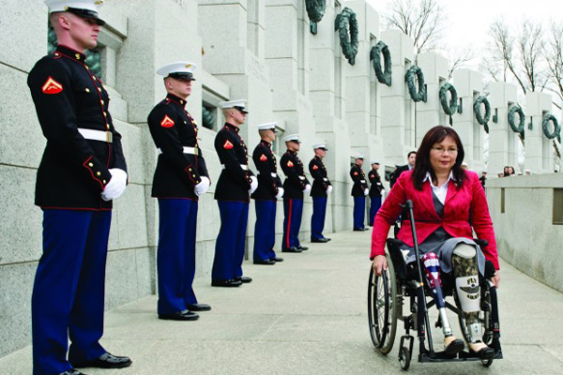
From every war, some soldiers return carrying permanent signs of war on their bodies.
Civil War Veterans
Civil War Vets
Tammy Duck-worth
World War 2
Veterans

Slide 11
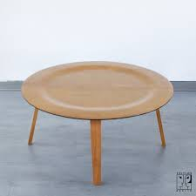

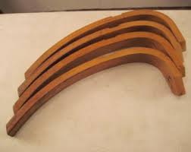
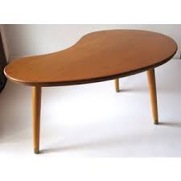
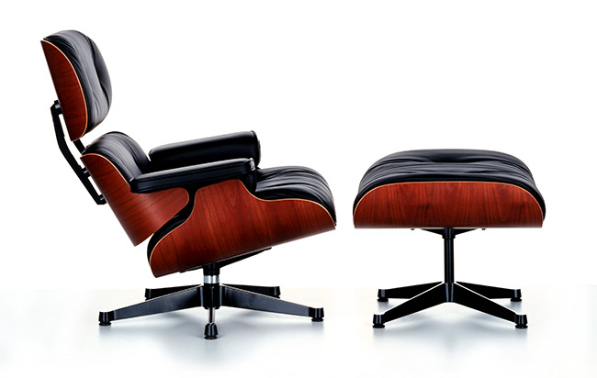


Ray and Charles Eames

Slide 12
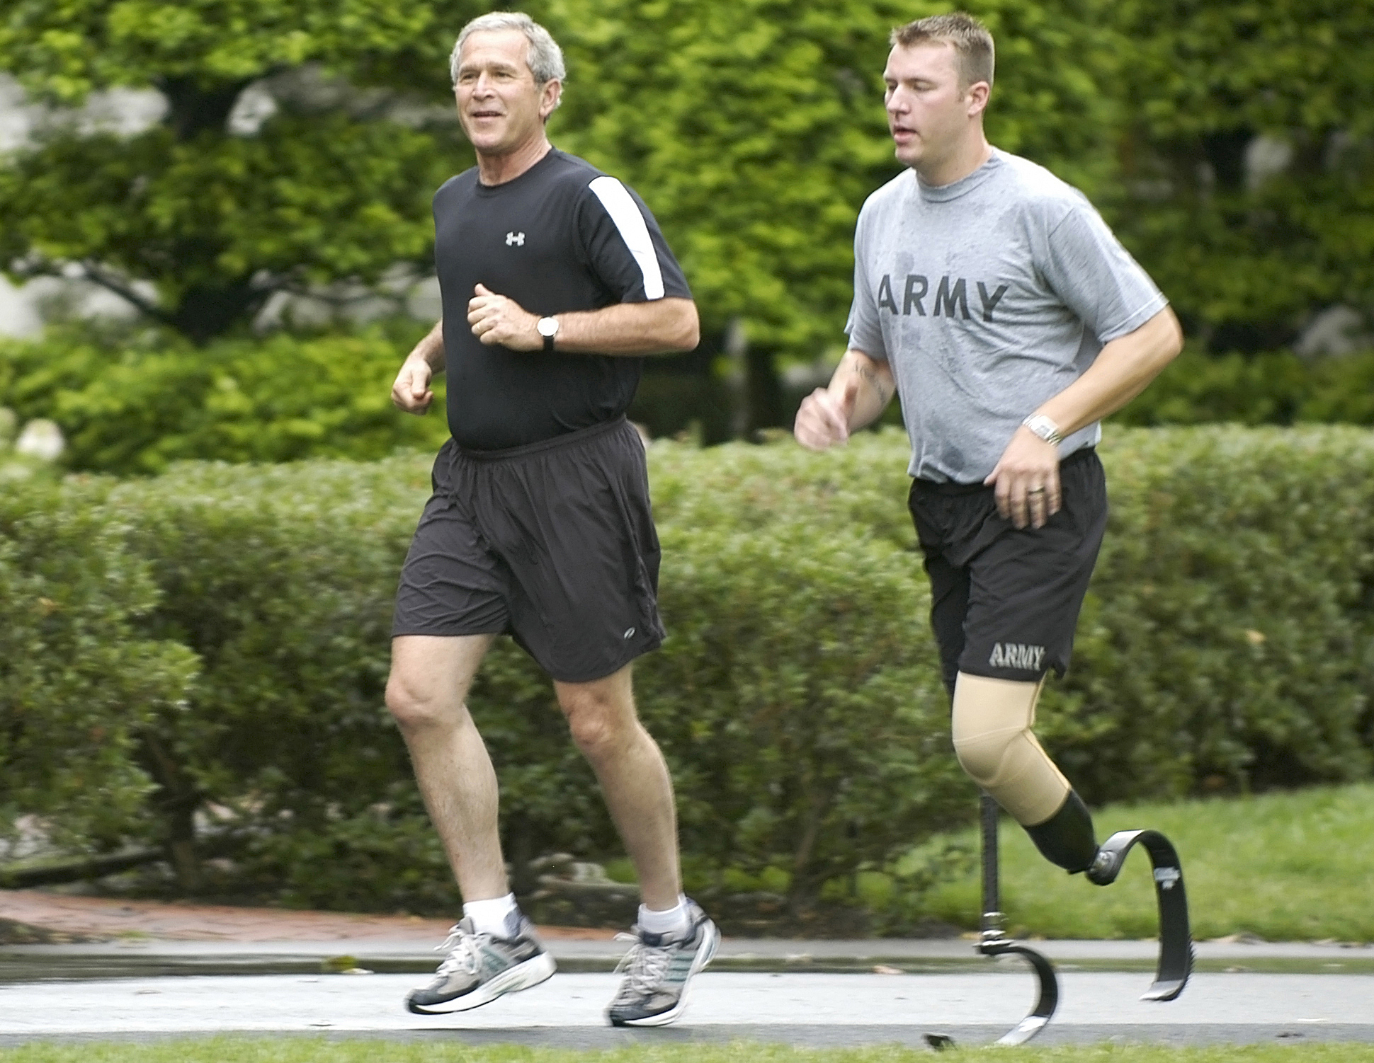
The Amputee as the Athlete.

Slide 13
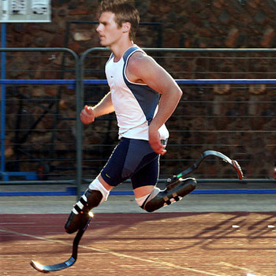
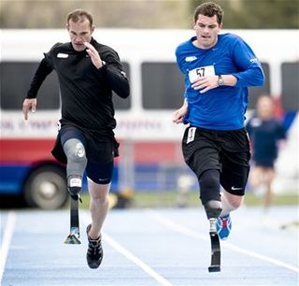
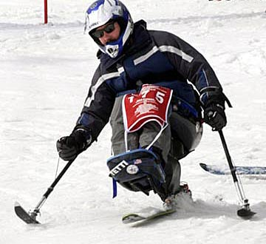
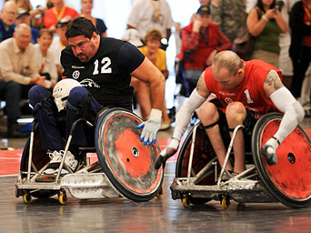

Slide 14
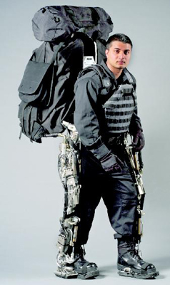
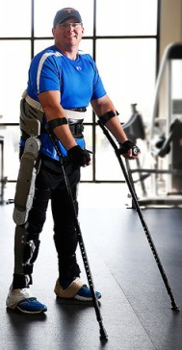
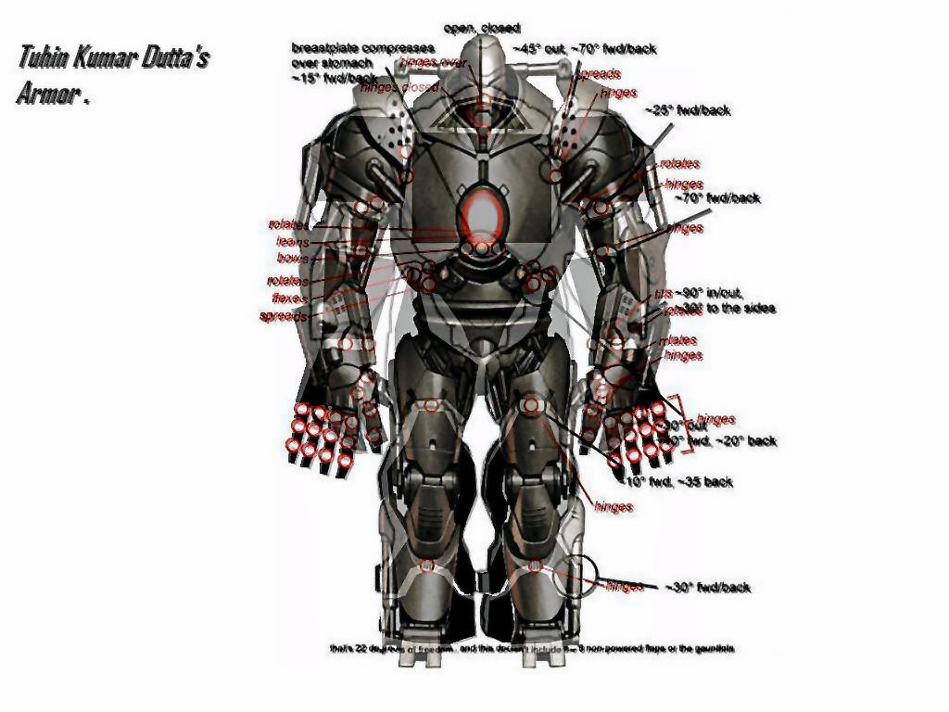
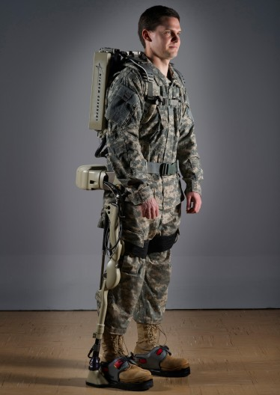
We live in an era in which not only avatars and other fantastic creatures run around cyber space in their exoskeletons, but engineers are now developing these devices for military use. When strapped on, they permit a 120 lb person to walk around with a 200 pound load.
We have met the cyborg, and it is us.

Slide 15
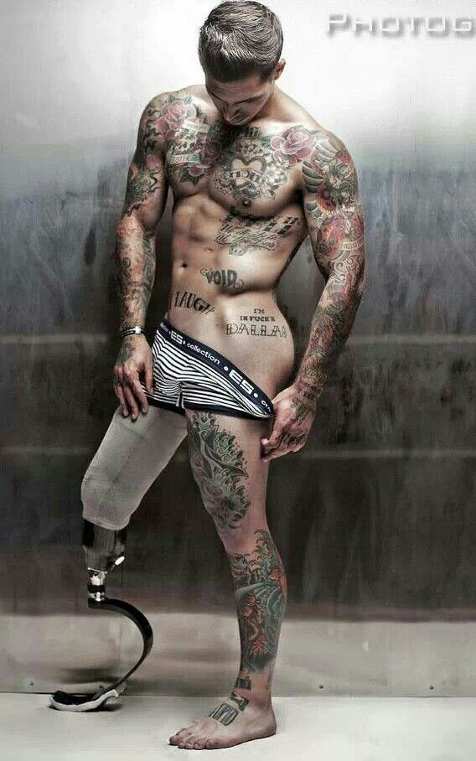
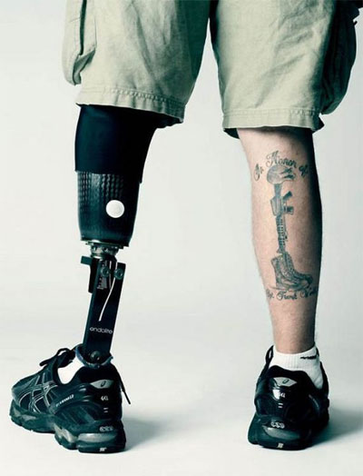
Alex Minsky, veteran turned model

Slide 16
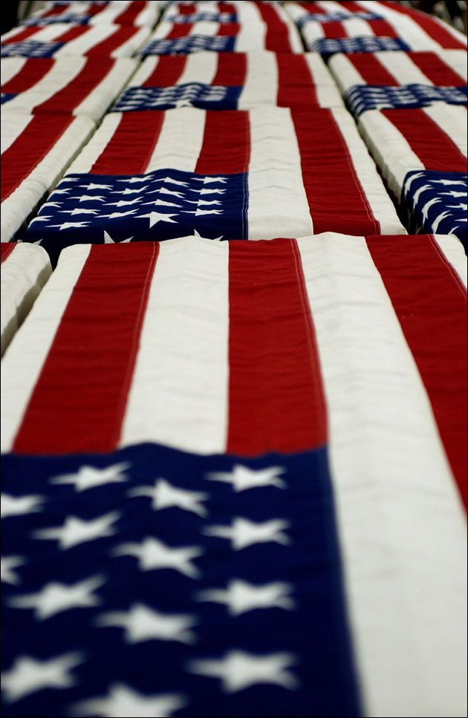
And for some, the return home is their final journey

Slide 17

Death is something that is prepared for.

Slide 18

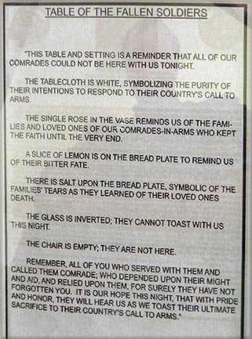
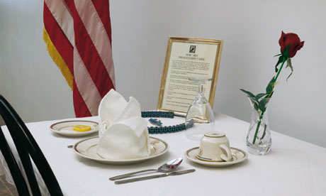
Table for the Fallen

Slide 19
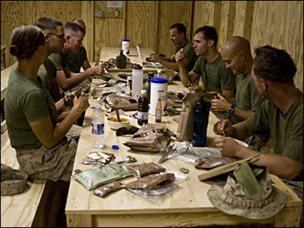

Slide 20
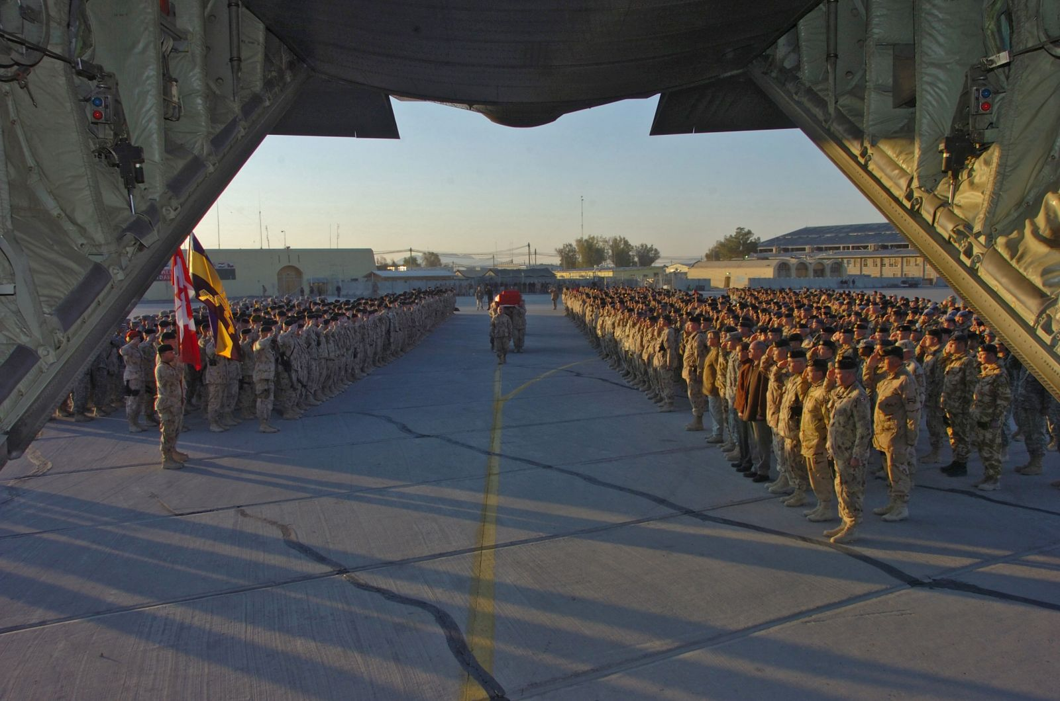
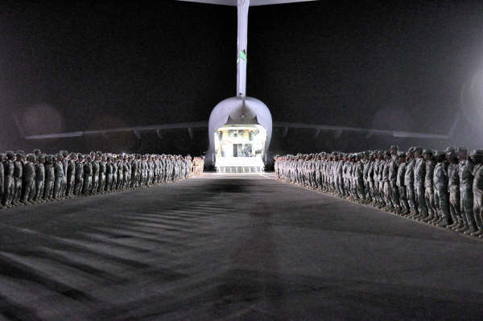
Commemeration of the Fallen
Ramp Ceremonies

Slide 21
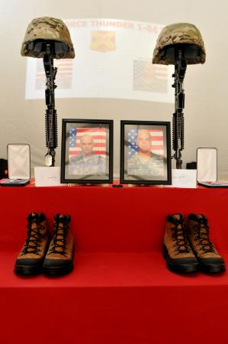
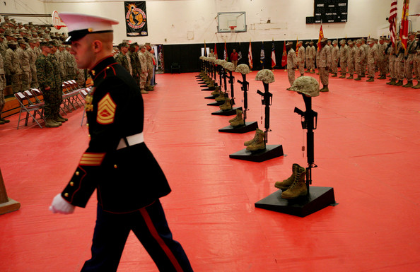
Unit Memorial Services
Sergeants Lammerts and Burgess

Slide 22

Honoring the Dead

